Slide 1
Project Title: Anti Sleep Alarm For Drivers
Project Review
Group 10
Team Members:-
Nitesh Kumar
Arjun Singh
Abdur Rahman
Ajith Kumar
Aishwarya Raikar

Slide 2
INTRODUCTION
Feeling sleepy while driving could cause a hazardous traffic accident. However, when driving alone on the highway or driving over a long period of time, drivers are inclined to feel bored and sleepy, or even fall asleep.
There is a high demand for cheap and efficient driver sleep detection. Therefore, we came up with an idea and successfully developed an Anti Sleep Alarm for Driver, which could effectively meet this demand.

Slide 3
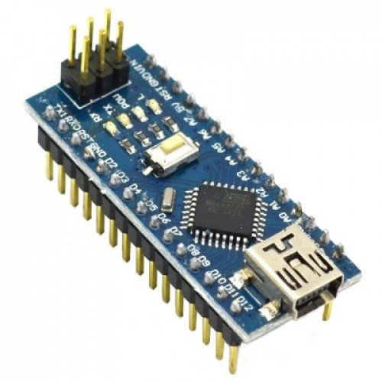
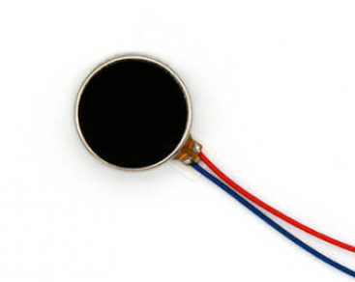
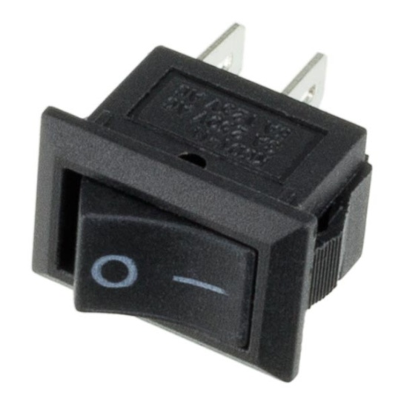
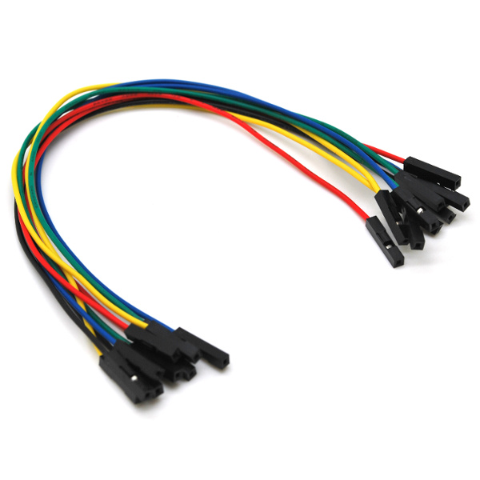
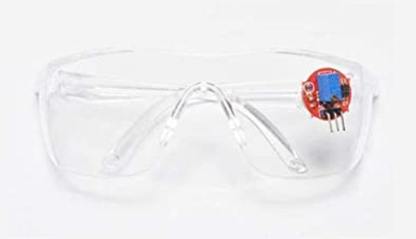
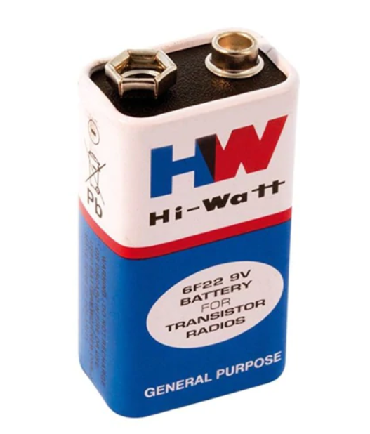
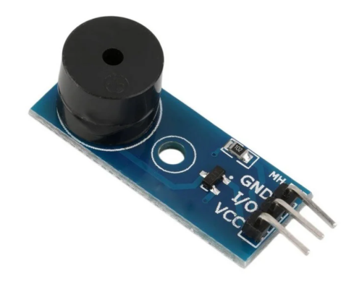
COMPONENTS AND SUPPLIES
Arduino Nano
Coin Vibration Motor
SPST Switch
Eye Blink Sensor
Jumper Wires
Active Buzzer
9V Battery

Slide 4
Arduino Nano
Coin Vibration Motor
Arduino Nano is a small, compatible open-source electronic development board based on an 8-bit AVR microcontroller.
Coin vibration motor is a typical ERM (eccentric rotating mass) actuators. It provides customer with haptic feedback
Eye Blink Sensor
SPST Switch
The eye blink sensor is an infrared sensor which illuminates the eye with infrared light and monitors the changes in the reflected light.
SPST switch stands for “Single Pole Single Throw” which includes a single input and a single output.
Jumper Wires
Jumper wires are simply wires that have connector pins at each end, allowing them to be used to connect two points to each other without soldering.
Active Buzzer
An active buzzer has a built-in oscillating source, so it will make sounds when electrified.
9V Battery
It is an electric battery that supplies a nominal voltage of 9 Volts

Slide 5

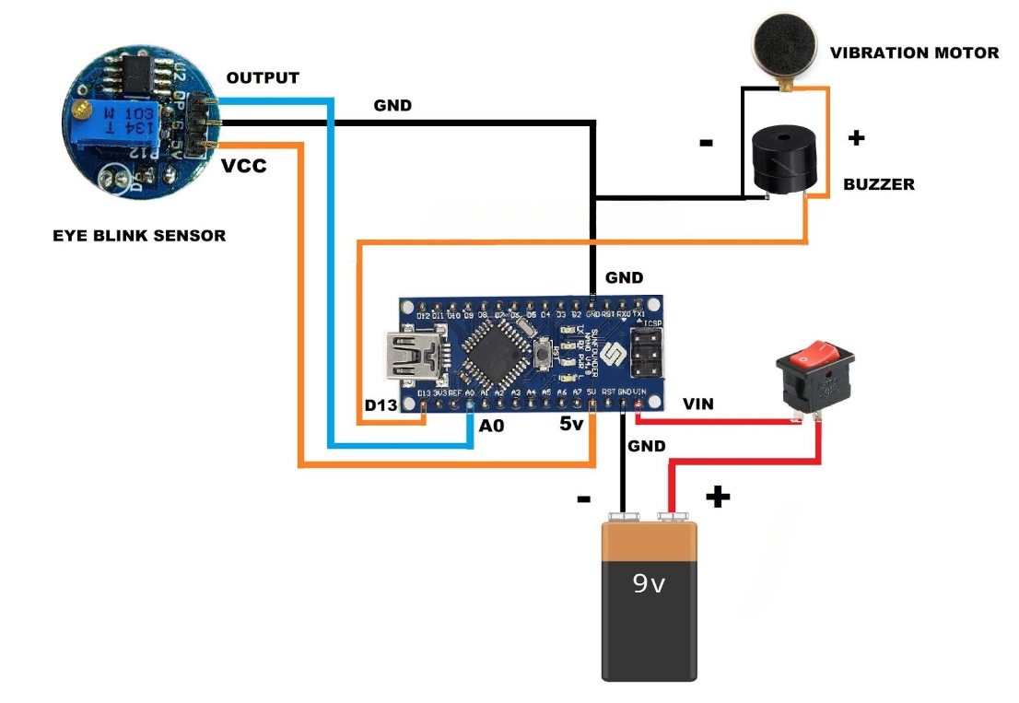
Circuit Diagram:

Slide 6


